Slide 1
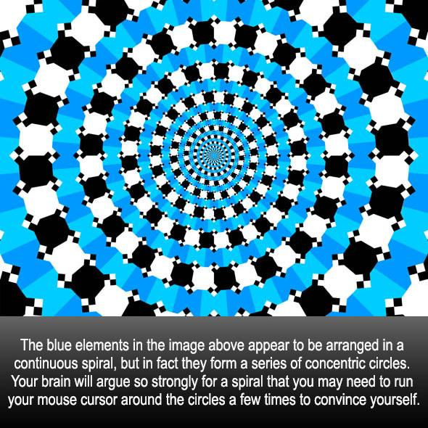

Slide 2
Dimitris Papailiopoulos
University of Wisconsin-Madison
Robustness of Predictions and Adversarial Examples

Slide 3
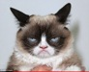
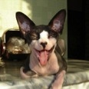
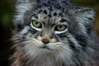
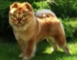


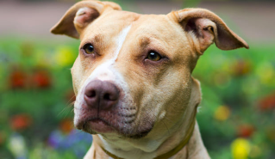
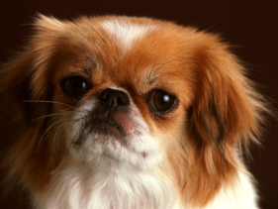
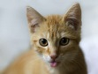
Standard ML Pipeline
Input Data

Slide 4
Standard ML Pipeline
Input Data
Training

Slide 5
Standard ML Pipeline
Input Data
Training
Model

Slide 6
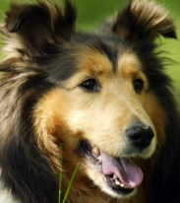
Standard ML Pipeline
This is called inference
Test (unseen) Data
Input Data
Training
Model
predicted
label:
“dog”

Slide 7
Today
Robustness of Models
Adversarial Examples
Attacks during Inference

Slide 8
Robustness of Classification
Robustness:
“The predictions are insensitive to small input perturbations”
Predict(model, ) ≈ Predict(model, )
Are classifiers robust?

Slide 9
Robustness Against Random Noise

Slide 10
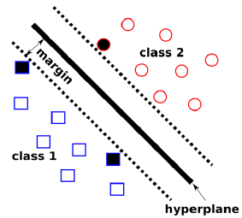
Robustness of Classification
Let’s study the linear case:
Assume some margin:
Prediction
Class 1
Class 2

Slide 11
Robustness of Classification
Assume additive perturbation
Gaussian 0-mean, unit variance
Assume that original input satisfies
Then, after noise is added
“γ-far” from boundary
How big is added term?

Slide 12
Robustness of Classification
Expected value
Variance

Slide 13
Robustness of Classification
Expected value
Variance

Slide 14
Robustness of Classification
Expected value
Variance

Slide 15
Robustness of Classification
Expected value
Variance

Slide 16
Robustness of Classification
For additive 0-mean, unit vector v,
The probability of misclasifying is
Probability that noise
obliterates margin

Slide 17
Robustness of Classification
For additive 0-mean, unit vector v,
The probability of misclasifying is
(standard Gaussian tail-bounds)
You need to misclasify
Ridiculously small!

Slide 18
Robustness of Classification
For additive 0-mean, unit vector v,
The probability of misclasifying is
(standard Gaussian tail-bounds)
You need to misclasify
Linear Classifiers are Robust
to Random noise
Ridiculously small!

Slide 19
Adversarial Examples

Slide 20

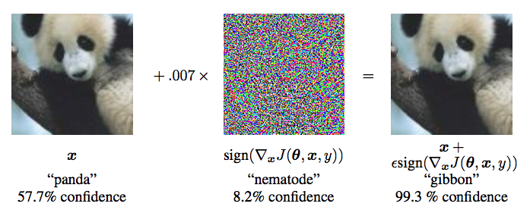
Adversarial Examples
Then, in 2014 something happened…
[Ian J. Goodfellow, Jonathon Shlens & Christian Szegedy, ICLR 2015]

Slide 21
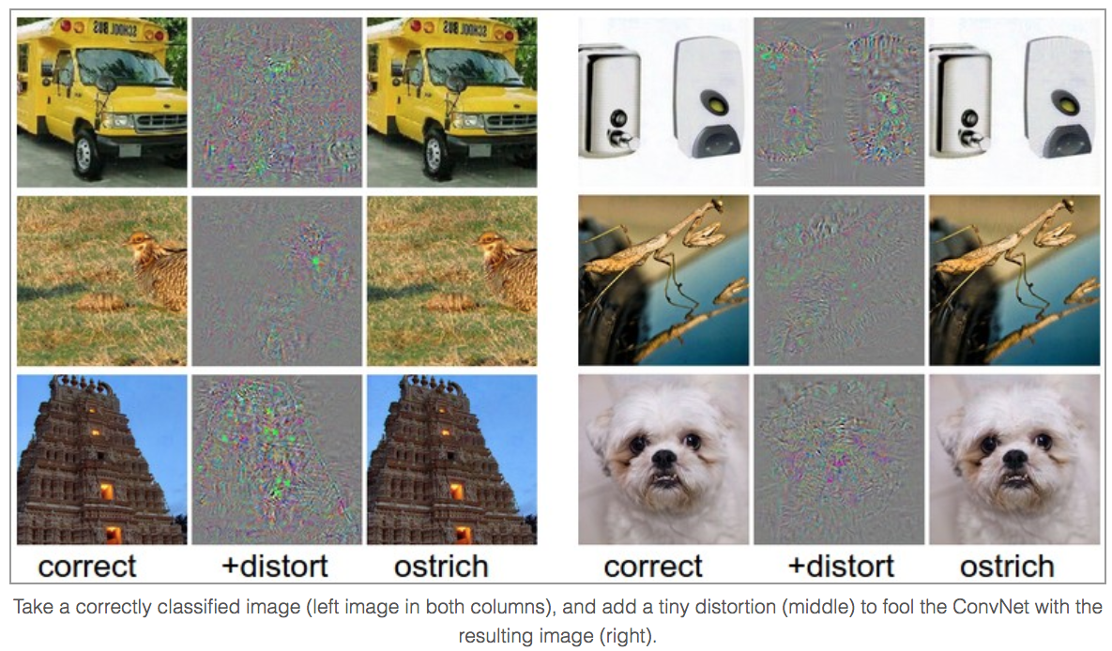
Adversarial Examples
[http://karpathy.github.io/2015/03/30/breaking-convnets/]

Slide 22
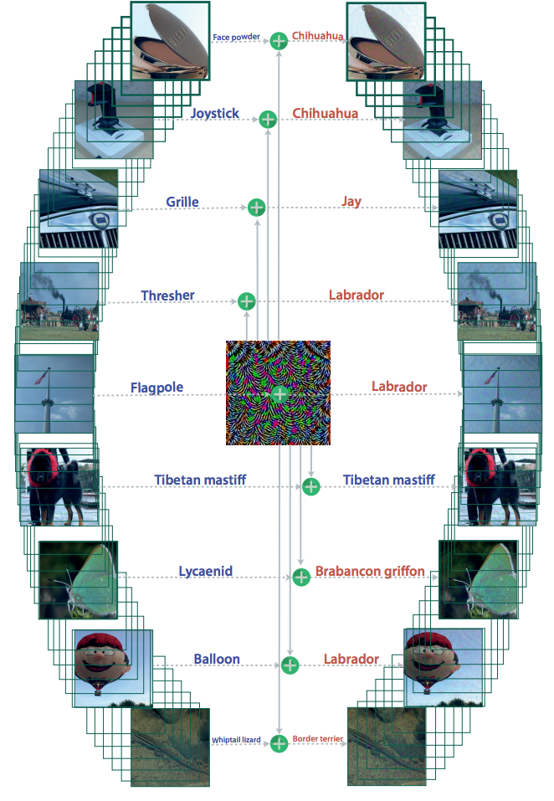
Universal Adversarial Examples
Even image agnostic noise
can break predictions
[Moosavi-Dezfooli, Fawzi,
Fawzi, Frossard, CVPR2017]

Slide 23
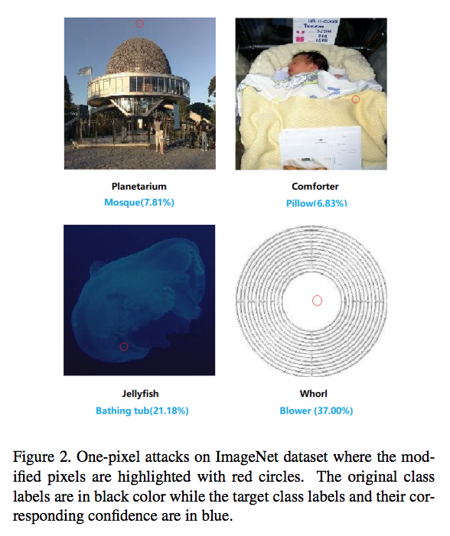
Single Pixel Attacks
[Su, Vargas, Kouichi 2017]

Slide 24
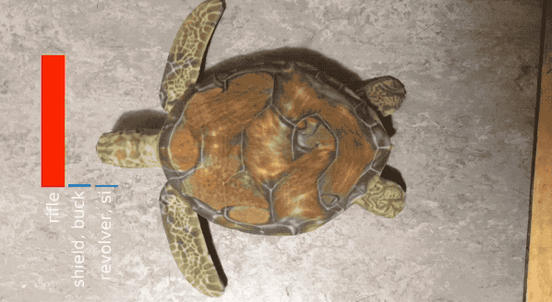
Adversarial Examples in Real Time

Slide 25
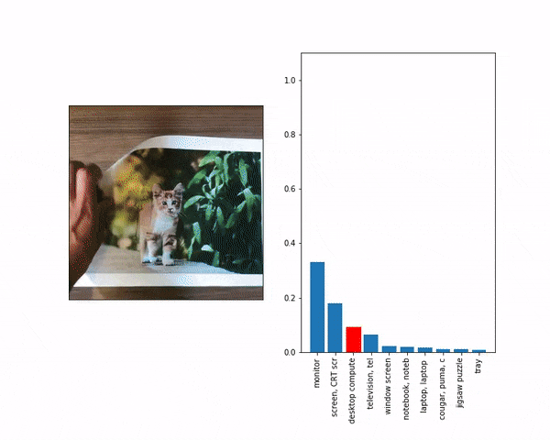
Adversarial Examples in Real Time

Slide 26
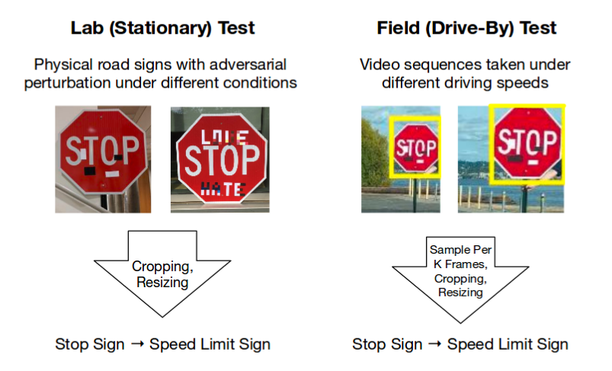
Adv. Example + ML in the wild
Eykholt, Evtimov, Fernandes, Bo Li, Rahmati,
Xiao, Prakash, Kohno, Song. CVPR2018]

Slide 27
Adversarial Examples: Why?
Classifiers are much less robust to adv. Noise
Let’s revisit the linear case

Slide 28
Worst-case Robustness
Let’s study the linear case:
Assume some margin:
Prediction
Class 1
Class 2

Slide 29
Worst-case Robustness
Assume additive perturbation
Unit norm
Q: What is the “worst” unit norm vector to add
Assume margin:
Goal
“γ-far” from boundary
How big is added term?

Slide 30
Worst-case Robustness
Worst case perturbation on linear models
Adversarial example
That is,
Worst-case noise
points towards boundary!

Slide 31
Worst-case Robustness
Worst case perturbation on linear models
Adversarial perturbation
Worst-case noise points
Towards boundary
How big is added term?

Slide 32
Worst-case Robustness
“Adversarial” Perturbation
Compare with Random Noise
Worst-case noise sqrt(d)
more effective!

Slide 33
Attacking Neural Networks

Slide 34
Robustness of Classification
Adversarial attack: Goal “maximize loss”!
max loss( predict( ); True Label )
st. norm( ) = small
goal
imperceptibility
How to formalize?

Slide 35
Threat Model

Slide 36
Threat Models
Simplest and still meaningful: “Black Box:”
just access to predictions
But, a powerful adversary can have access to:
predictions
gradients
model architecture
training data set
Training algorithm + defense mechanism
Compute power
Predict(x)
Input
Output

Slide 37
Types of Attack
Untargeted
Targeted
Different kinds of noise
can be l-0, l-infinity or l-2 bounded
Predict( ) = anything but cat
Predict( ) = Badger

Slide 38
General Attack Mechanism
Goal for a general learning problem
Taylor’s linear approximation
Linear approx problem
Goal: max this term

Slide 39
Fast Gradient Sign Method
Linear optimization
Usually p = ∞. Optimal perturbation:
FGSM:

Slide 40
Fast Gradient Sign Method
Linear optimization
Usually p = ∞
Iterative FGSM:

Slide 41
Fast Gradient Sign Method
Linear optimization
Usually p = ∞
Iterative targeted FGSM:
FGSM currently one of the fastest and effective attacks

Slide 42
Other Attack Frameworks

Slide 43
Szegedy et al. (2014)
Box constrained L-BFGS
Targeted attack

Slide 44
DeepFool (2016)
Un-targeted attack

Slide 45
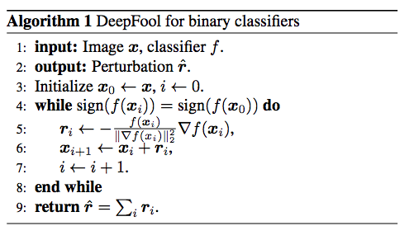
DeepFool (2016)
Un-targeted attack

Slide 46
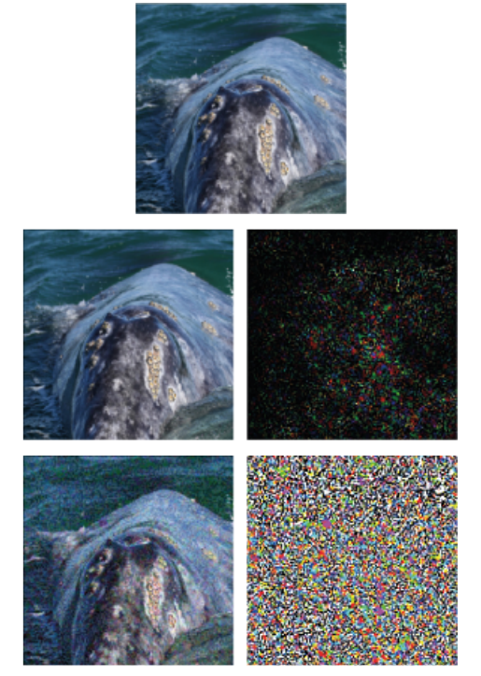
DeepFool
FGSM

Slide 47
C&W framework (2017)
Generalization of Szegedy et al

Slide 48
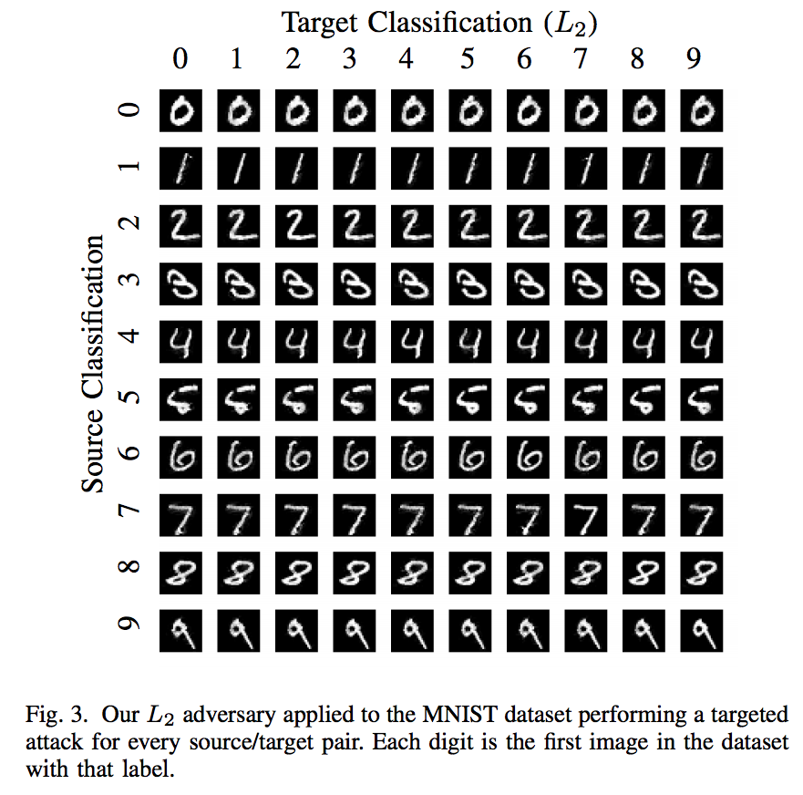
C&W framework (2017)

Slide 49
Defense??
Can we design defense mechanisms??
Defense
Predict(x)
Input
Output

Slide 50
Next time
Defense against Adv. Examples
Adversarial Attacks During Training
Robust Training

Slide 51
The end

